Slide 1
The Effect of Pyramid and Wedge Acoustic Foam on Reducing Decibel Level
Abby Bault – Center Line
Amanda Hercula – Warren Mott

Slide 2

Table of Contents
Background
Problem
Hypothesis
Materials and Procedures
Data Collected
Statistical Tests
Conclusion
Errors Made
Further Research
Real World Application
Recap
Acknowledgements
Questions

Slide 3
Background
Sound – how it’s measured
Soundproofing – lower decibel level
Acoustic Foam

Slide 4
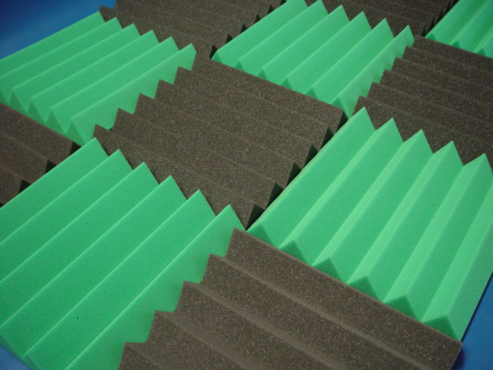
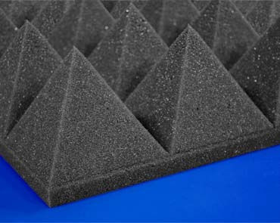
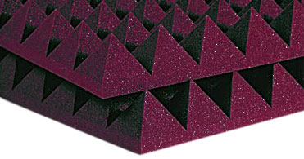
Acoustic Foam Used
Wedge Foam
Pyramid Foam
http://www.foambymail.com/blog/refine-a-rooms-sound-with-custom-acoustical-sound-treatment/
http://www.foambymail.com/AP4/acoustical-4-pyramid-foam.html

Slide 5
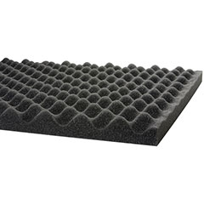
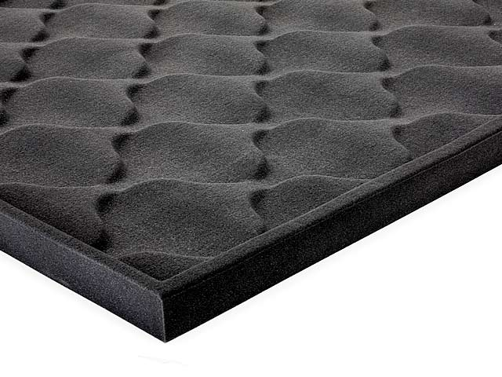
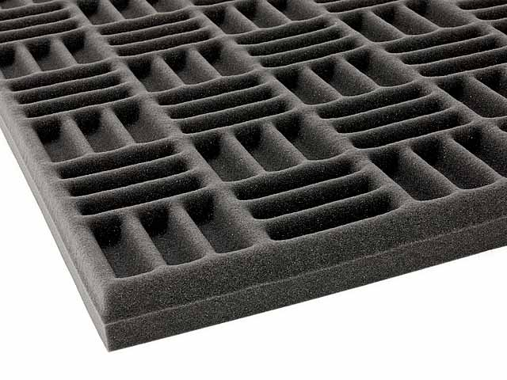
Other Acoustic Foam
Eggcrate Foam
Spade Foam
Grid Foam
http://www.parts-express.com/pe/showdetl.cfm?partnumber=260-516
http://www.thefoamfactory.com/blog/index.php/get-detailed-and-precise-products-with-foam-compression-cutting
http://canada.foambymail.com/ACG-/acoutical-grid-foam.html

Slide 6
How to Soundproof
Foam goes on walls
Can go between walls

Slide 7
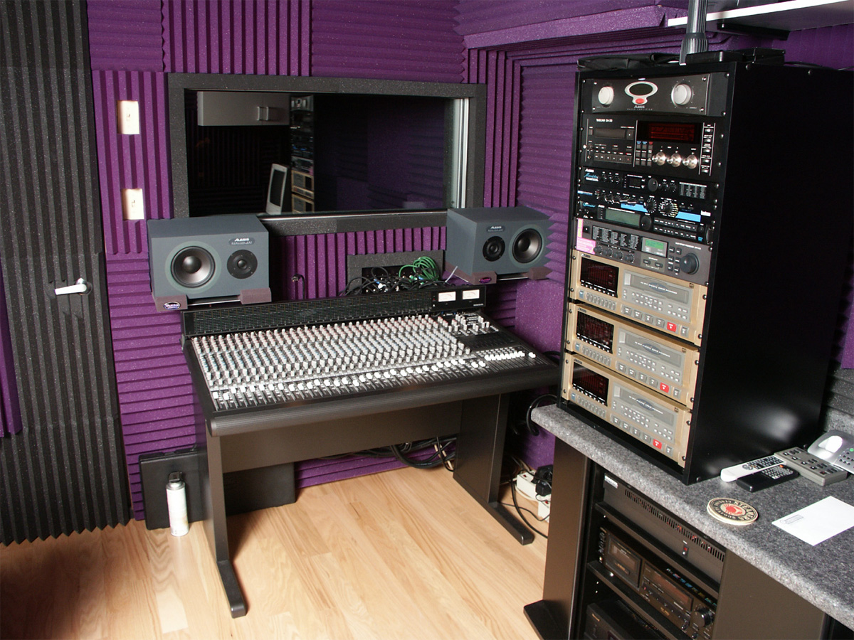
How to Soundproof
http://www.auralexelite.com/applicatons/residential_home_studio.asp

Slide 8
Problem Statement
To determine which type of acoustic foam – pyramid or wedge – is most effective for absorbing sound waves and therefore reducing the decibel level of the music played.

Slide 9
Hypothesis
If the decibel level of each trial is measured when each trial is run under the same conditions, then the wedge foam will absorb the most sound waves and therefore reduce the decibel level the most.

Slide 10
The Box Materials
(2) 24 x 12 inch pieces of plywood
(2) 23 x 11-1/2 inch pieces of plywood
(2) 24 x 24 inch pieces of plywood
(2) 21 x 11-1/2 inch pieces of plywood
(2) 21-1/2 x 11-1/2 inch piece of plywood
21-1/2 x 21 inch piece of plywood
1-1/8 inch Fine Drywall Screws

Slide 11
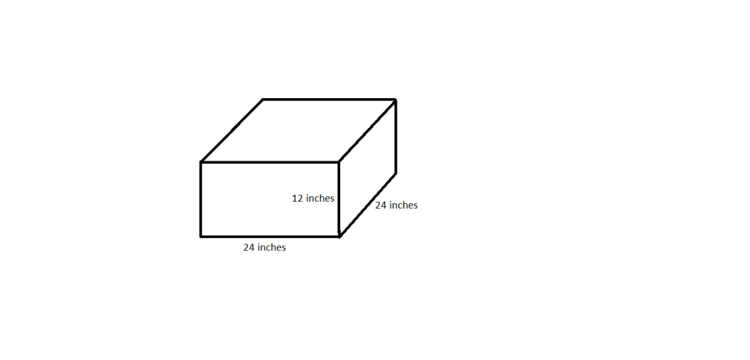
Building The Box: Outer
Attach the 24 x 12 inch pieces to the 24 x 24 inch base.
Attach the 23 x 11-1/2 inch to the 24 x 24 inch base.
12 inches
24 inches
23 inches

Slide 12
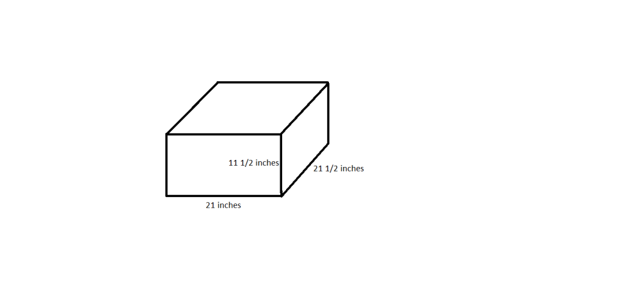
Building The Box: Inner
Attach the 21-1/2 x 11-1/2 pieces to the base.
Attach the 21 x 11-1/2 inch to the 24 x 24 inch base.
11 1/2 inches
21 inches
21 1/2 inches

Slide 13
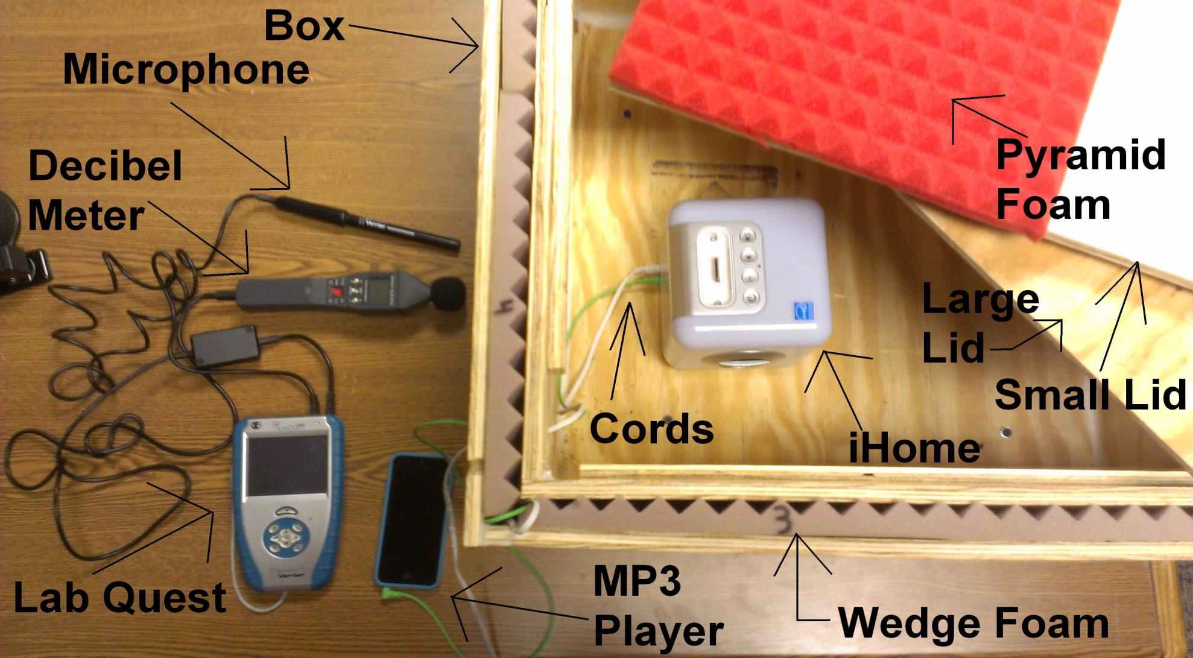
Materials

Slide 14
Procedures
Place iHome, labquest, and decibel meter in spots and plug in all cords
Place inner lid on box
Insert the foam

Slide 15
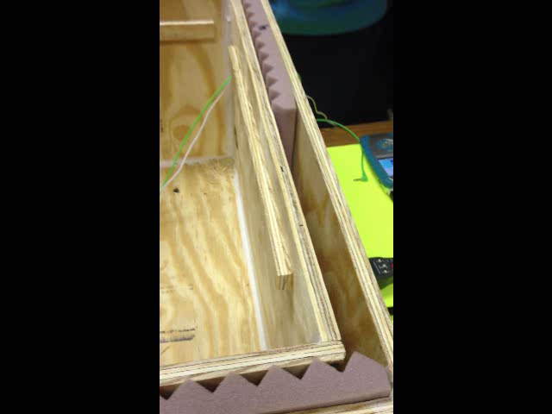
How to Insert Foam

Slide 16
Procedures
Place outer lid on box
Begin playing music
Record data and listen for background noise
Record observations

Slide 17
Data
Type of Foam | Decibel Level (dB)
 | Mean
Pyramid | 15.124
Wedge | 1.734
None | 16.930

Slide 18
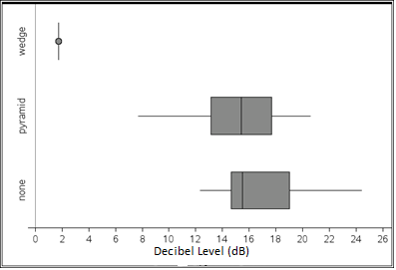
Data

Slide 19
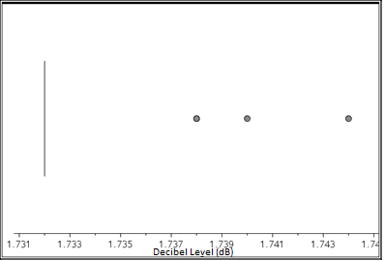
Wedge Foam

Slide 20
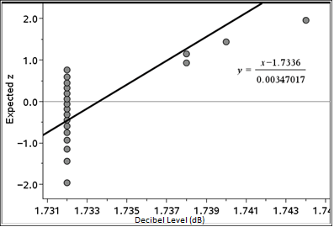
Wedge Foam

Slide 21
ANOVA – Analysis of Variance
ANOVA determines if there is a difference in the means of three or more populations.
  Independent SRS
  Normally distributed
  Same sample standard deviation
    Rule of thumb

Slide 22
ANOVA – Analysis of Variance
H_{o}: µ_{w} = µ_{n} = µ_{p}
H_{a}: not all µ_{w}, µ_{n}, µ_{p} are equal

Slide 23
Results of ANOVA
p-value 6.45*10⁻²⁵
Reject H_{o}.
There is a difference in the means of the pyramid foam, no foam, and wedge foam.

Slide 24
Two-Sample t test
Two–Sample t tests compare the means of two different populations
Pyramid and no foam
Why not wedge?

Slide 25
Assumptions
Simple random sample – SRS
Independent samples
Normally distributed

Slide 26
Two-Sample t test
H_{o}: µ_{p} = µ_{n}
H_{a}: µ_{p} < µ_{n}

Slide 27
Results of t test
p-value .053
Fail to reject H_{o}.
There was no difference between no foam and pyramid foam.

Slide 28
Results of t test
Not significant at α level
Experiment should be run again
Time constraints

Slide 29
Conclusion
Hypothesis accepted
Wedge foam is most effective
  Surface area
    Diffusion

Slide 30
Errors & Inconsistencies
Ripped foam
Air vent
Copy room noise

Slide 31
Further Research
Recording studio
Different types of foam
  Recall eggcrate, spade, and grid
Different type of box

Slide 32
Real World Application
Recording studios
  Professional and at home
Help artists get discovered

Slide 33
Recap
Acoustic foam
Statistical tests and p-value
Hypothesis accepted
How it is useful

Slide 34
Acknowledgements
Mrs. Cybulski & Mrs. Tallman
Mr. McMillan
Mr. Hercula
Joey McLennan

Slide 35
Works Cited
"4" Pyramid Foam." Foam Factory, Inc. N.p., 2013. Web. 04 June 2013. <http://www.foambymail.com/AP4/acoustical-4-pyramid-foam.html>.
"Acoustic Grid Foam." Foam Factory, Inc. The Foam Factory, n.d. Web. 04 June 2013. <http://canada.foambymail.com/ACG-/acoutical-grid- foam.html>.
"Acoustic Sound Damping Foam." Acoustic Foam. Parts Express, 2 June 2011. Web. 04 June 2013. <http://www.parts- express.com/pe/showdetl.cfm?partnumber=260-516>.

Slide 36
Works Cited
"Applications / Residential / Residential Home Studios." Auralex Acoustics. Auralex Acoustics, 2013. Web. 04 June 2013. <http://www.auralexelite.com/applicatons/residential_home_studio .asp>.
"Get Detailed and Precise Products with Foam Compression Cutting | The Foam Factory." The Foam Factory. The Foam Factory, n.d. Web. 04 June 2013. <http://www.thefoamfactory.com/blog/index.php/get- detailed-and-precise-products-with-foam-compression-cutting>.
"Refine a Room’s Sound With Custom Acoustical Sound Treatment." The Foam Factory. Foam Factory, 5 July 2012. Web. 04 June 2013. <http://www.foambymail.com/blog/refine-a-rooms-sound-with- custom-acoustical-sound-treatment/>.

Slide 37
Any Questions?

