Slide 1
Hand Washing
Rosemary Hermiz – Fitzgerald
Niki Qureshi – Fitzgerald

Slide 2
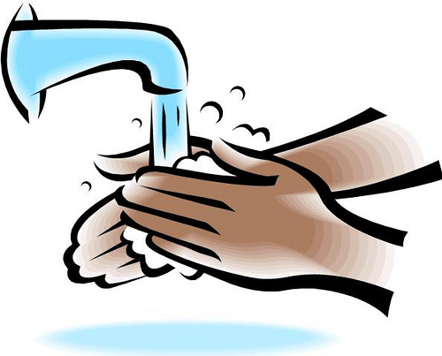
http://www.clipartbest.com/cliparts/RTA/kGg/RTAkGggTL.jpeg

Slide 3
http://thumbs.dreamstime.com/x/hands-hold-fruit-22769462.jpg

Slide 4
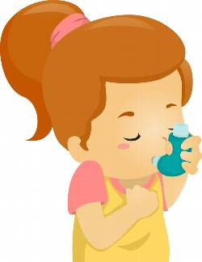
http://us.cdn3.123rf.com/168nwm/lenm/lenm1211/lenm121100066/16174397-illustration-of-an-asthmatic-girl-using-an-inhaler.jpg

Slide 5
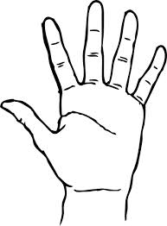
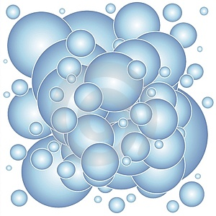
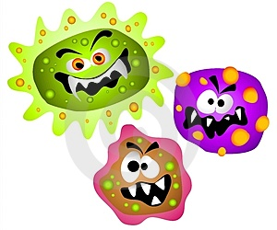

Slide 6
Our Story
Clearly hand washing is vital to our well being
We later discovered that very few people wash their hands as often as they should
Many do not even wash their hands properly
This is why we focused our experiment on finding the most effective procedure of hand washing

Slide 7
Problem Statement
The purpose of this experiment is to discover the effect of temperature and duration of water when washing one’s hands.
Using varying temperatures and different durations will provide knowledge on whether these factors significantly affect the number of bacterial colonies

Slide 8
Hypothesis
If the duration of washing one’s hands is prolonged, then more bacterial colonies will be eliminated. The temperature will not affect the bacterial colonies.

Slide 9
Predictor Variables
Temperature (degrees Fahrenheit) | Duration (seconds)
- | Standard | + | - | Standard | +
95°F | 100°F | 105°F | 5 sec | 15 sec | 25 sec
Temperature (degrees Fahrenheit) | Duration (seconds)

Slide 10
Materials
Petri dish
Sharpie

Slide 11
Materials
Soap

Slide 12
Materials
Thermometer

Slide 13
Materials
Agar

Slide 14
Materials
Timer

Slide 15
Materials
Incubator

Slide 16
Materials
Test tubes

Slide 17
Materials
Eyedropper
Cotton swab
Graduated cylinder
Sterile Water

Slide 18
Procedure

Slide 19
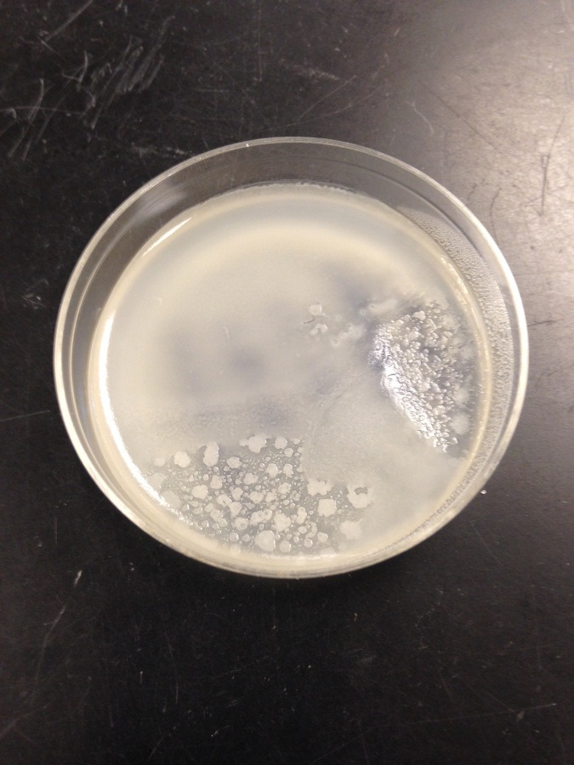
Measurement
Specs
Lawn

Slide 20
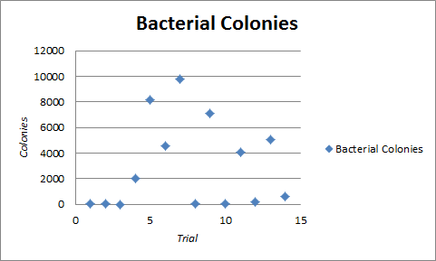
Range of Standards

Slide 21
Results
The longer the duration, the greater time slot for friction and the soap to come in contact
Soap and water does not kill bacteria
Soap contains hydrophilic and hydrophobic molecules
Friction is a main component of hand washing

Slide 22
Results
Temperature was not a significant factor
High temperatures do kill bacteria
The degree of temperature needed to kill is much too hot for the human hand

Slide 23
Interaction

Slide 24
Results
No effects fell within the fences, therefore they were not statistically significant.
Duration had a noticeably greater distance from zero.
Duration played a significant role in hand washing.
-15695/28
12113/28
41473/28

Slide 25
Significance of Data
Even if within the range of standards, duration proved to be significant
Compared to the interaction effect and temperature, duration was evidently within a higher range
As stated in our hypothesis, duration played a significant role while temperature did not.

Slide 26
Recap
Wash hands of volunteering students and collected data for 70 trials
While none of the effects fell out of the range of standards, duration did prove to have a significance

Slide 27
Improvements
Sample bacteria on hands before and after washing
Used a wider amount of people
More trials

Slide 28
Any Questions?

Slide 29
Works Cited
"Hygiene Fast Facts." Centers for Disease Control and Prevention. Centers for Disease Control and Prevention, 08 July 2013. Web. 26 May 2014.
"HowStuffWorks "Is Antibacterial Soap Any Better than Regular Soap?""HowStuffWorks. N.p., n.d. Web. 22 May 2014.
"The Water Race: Hydrophobic & Hydrophilic Surfaces." The Water Race: Hydrophobic & Hydrophilic Surfaces. National Nanotechnology Infrastructure Network, n.d. Web. 23 May 2014.
"How Does Water Kill Bacteria?" WikiAnswers. Answers Corporation, n.d. Web. 22 May 2014.
http://www.clipartbest.com/cliparts/RTA/kGg/RTAkGggTL.jpeg
http://thumbs.dreamstime.com/x/hands-hold-fruit-22769462.jpg
http://us.cdn3.123rf.com/168nwm/lenm/lenm1211/lenm121100066/16174397-illustration-of-an-asthmatic-girl-using-an-inhaler.jpg
Chan, Amanda L. "Proper Hand-Washing: Only 5 Percent Of Us Do It Right, Study Finds." The Huffington Post. TheHuffingtonPost.com, 11 June 2013. Web. 02 June 2014.

