Slide 1
What if...?
What if there was a natural way to cure cancer?
Lemons contain limonin
Not enough to effectively kill cancer cells.
However, this does not make lemons useless.

Slide 2
Effect of Lemon Juice Concentrate and Temperature on Escherichia Coli
Emily Eskuri - Fraser High School
Meredith Hinz - Cousino High School

Slide 3
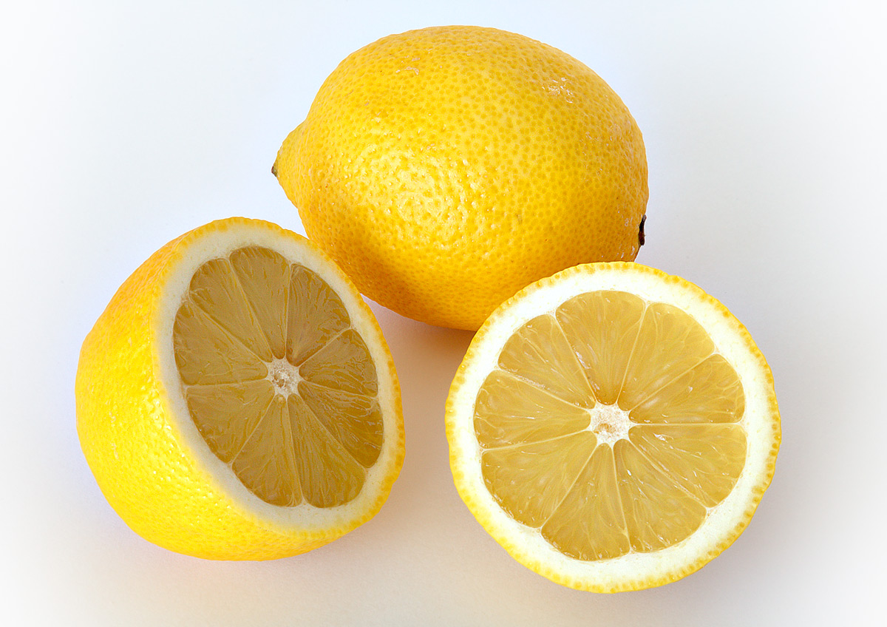
Background Info on Lemons
The juice of a lemon is 5%-6% citric acid.
Its citric acid has a low pH of 2.
Breaks down cell membranes
http://upload.wikimedia.org/wikipedia/commons/e/e4/Lemon.jpg
Eskuri-Hinz
1

Slide 4
Background Info on E. coli
Found in intestines of humans.
Usually harmless.
Formed 102 million years ago.
Eskuri-Hinz
2

Slide 5
Overview
Problem
Hypothesis
Materials
Procedure
Results
Eskuri-Hinz
3

Slide 6
Problem
The effect of Escherichia coli in lemon juice concentrate and different temperatures.
Eskuri-Hinz
4

Slide 7
Factors and Values
Lemon Juice Concentration (micro liters) |  |  | Temperature (degrees Celsius)
- | Standard | + | - | Standard | +
1 | 2 | 3 | 36 | 37 | 38
The growth rate is measured by the change in density over a certain period of time.
Eskuri-Hinz
5

Slide 8
Hypothesis
The high-high (+,+) value of 3 microliters of lemon juice concentrate and 38 degrees Celsius will have the most effect on the Escherichia coli.
Eskuri-Hinz
6

Slide 9
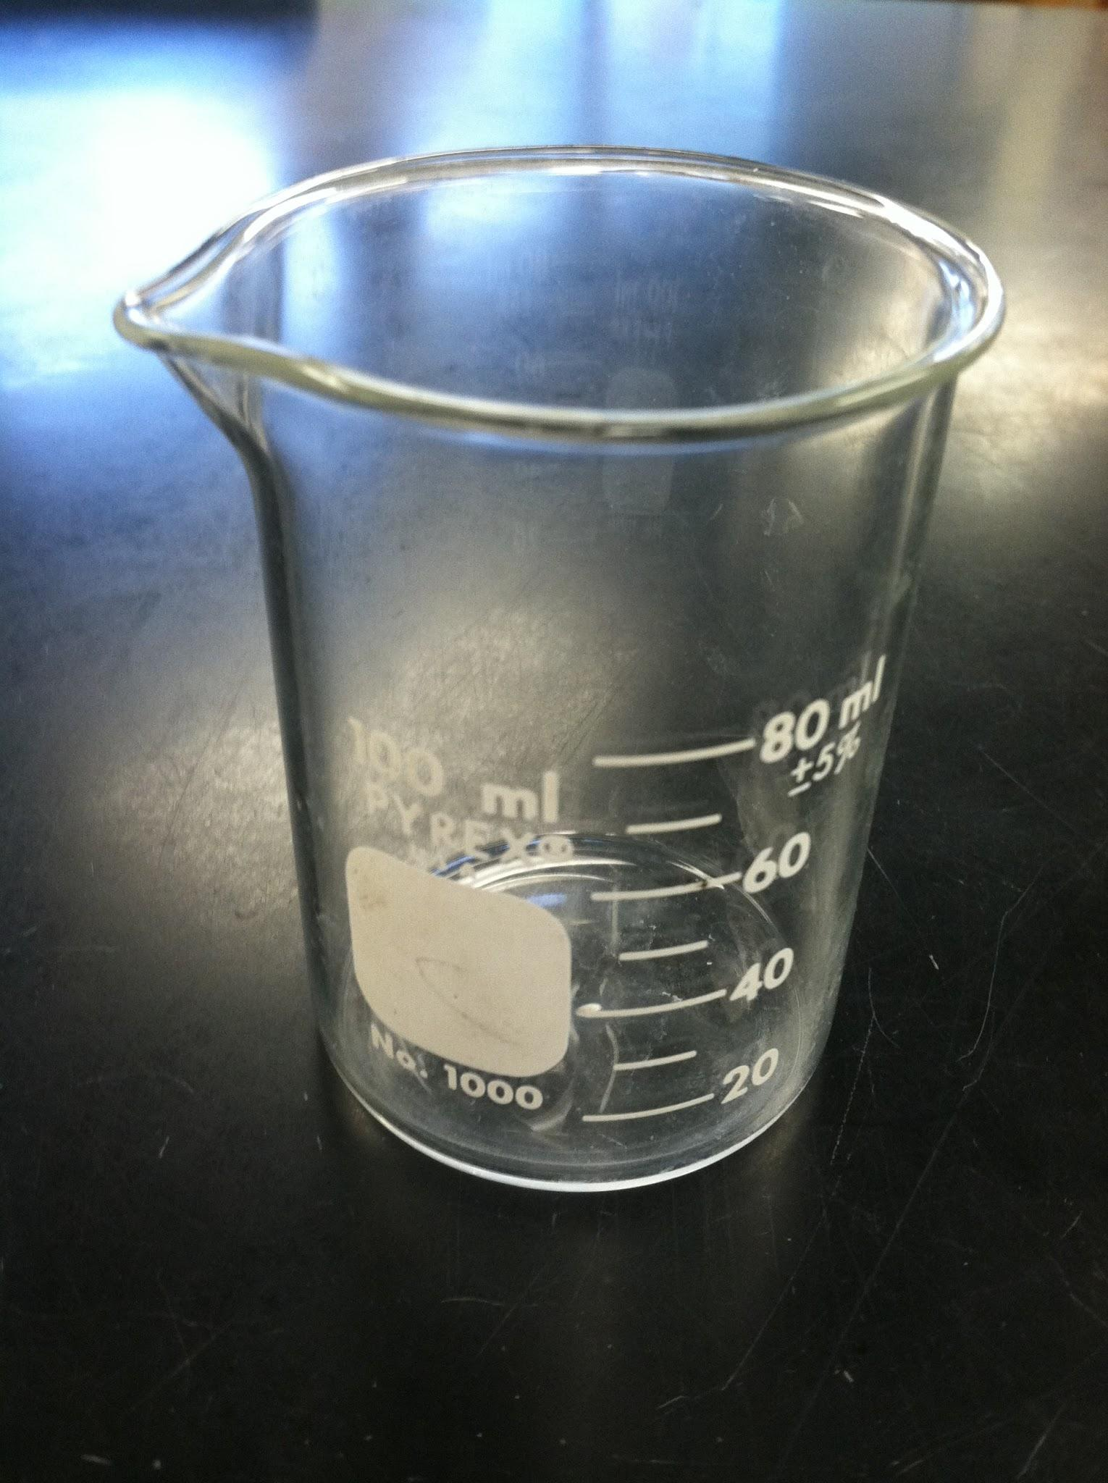
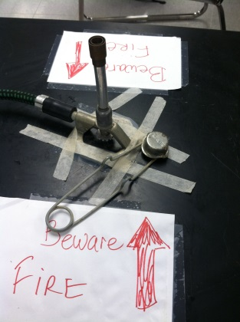
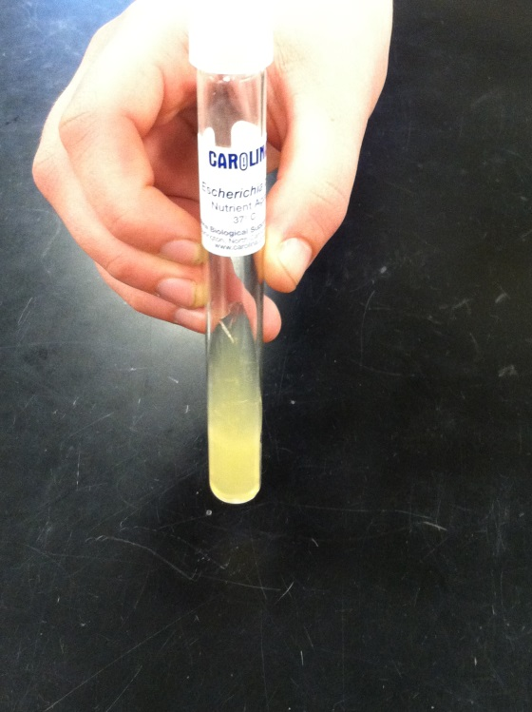
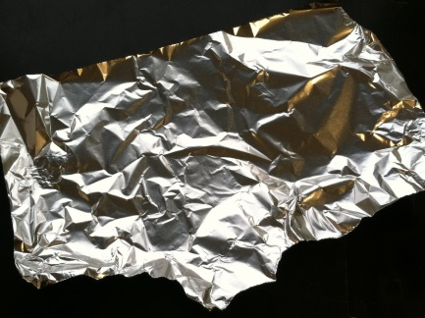
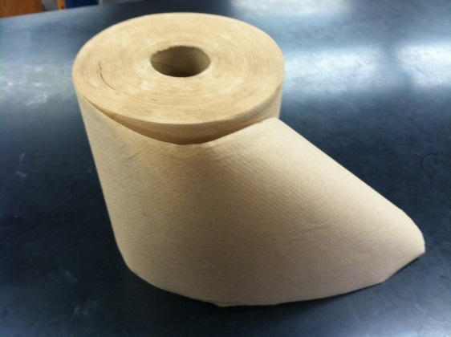
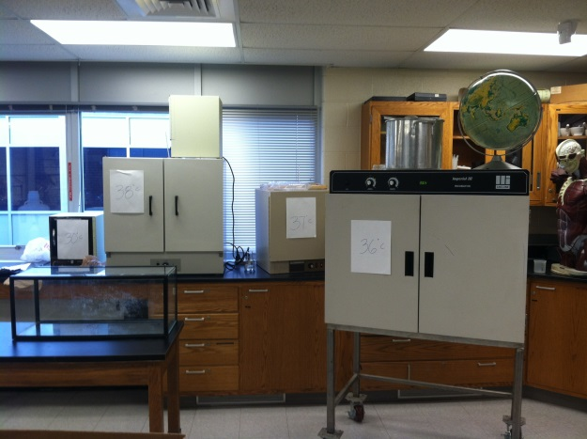
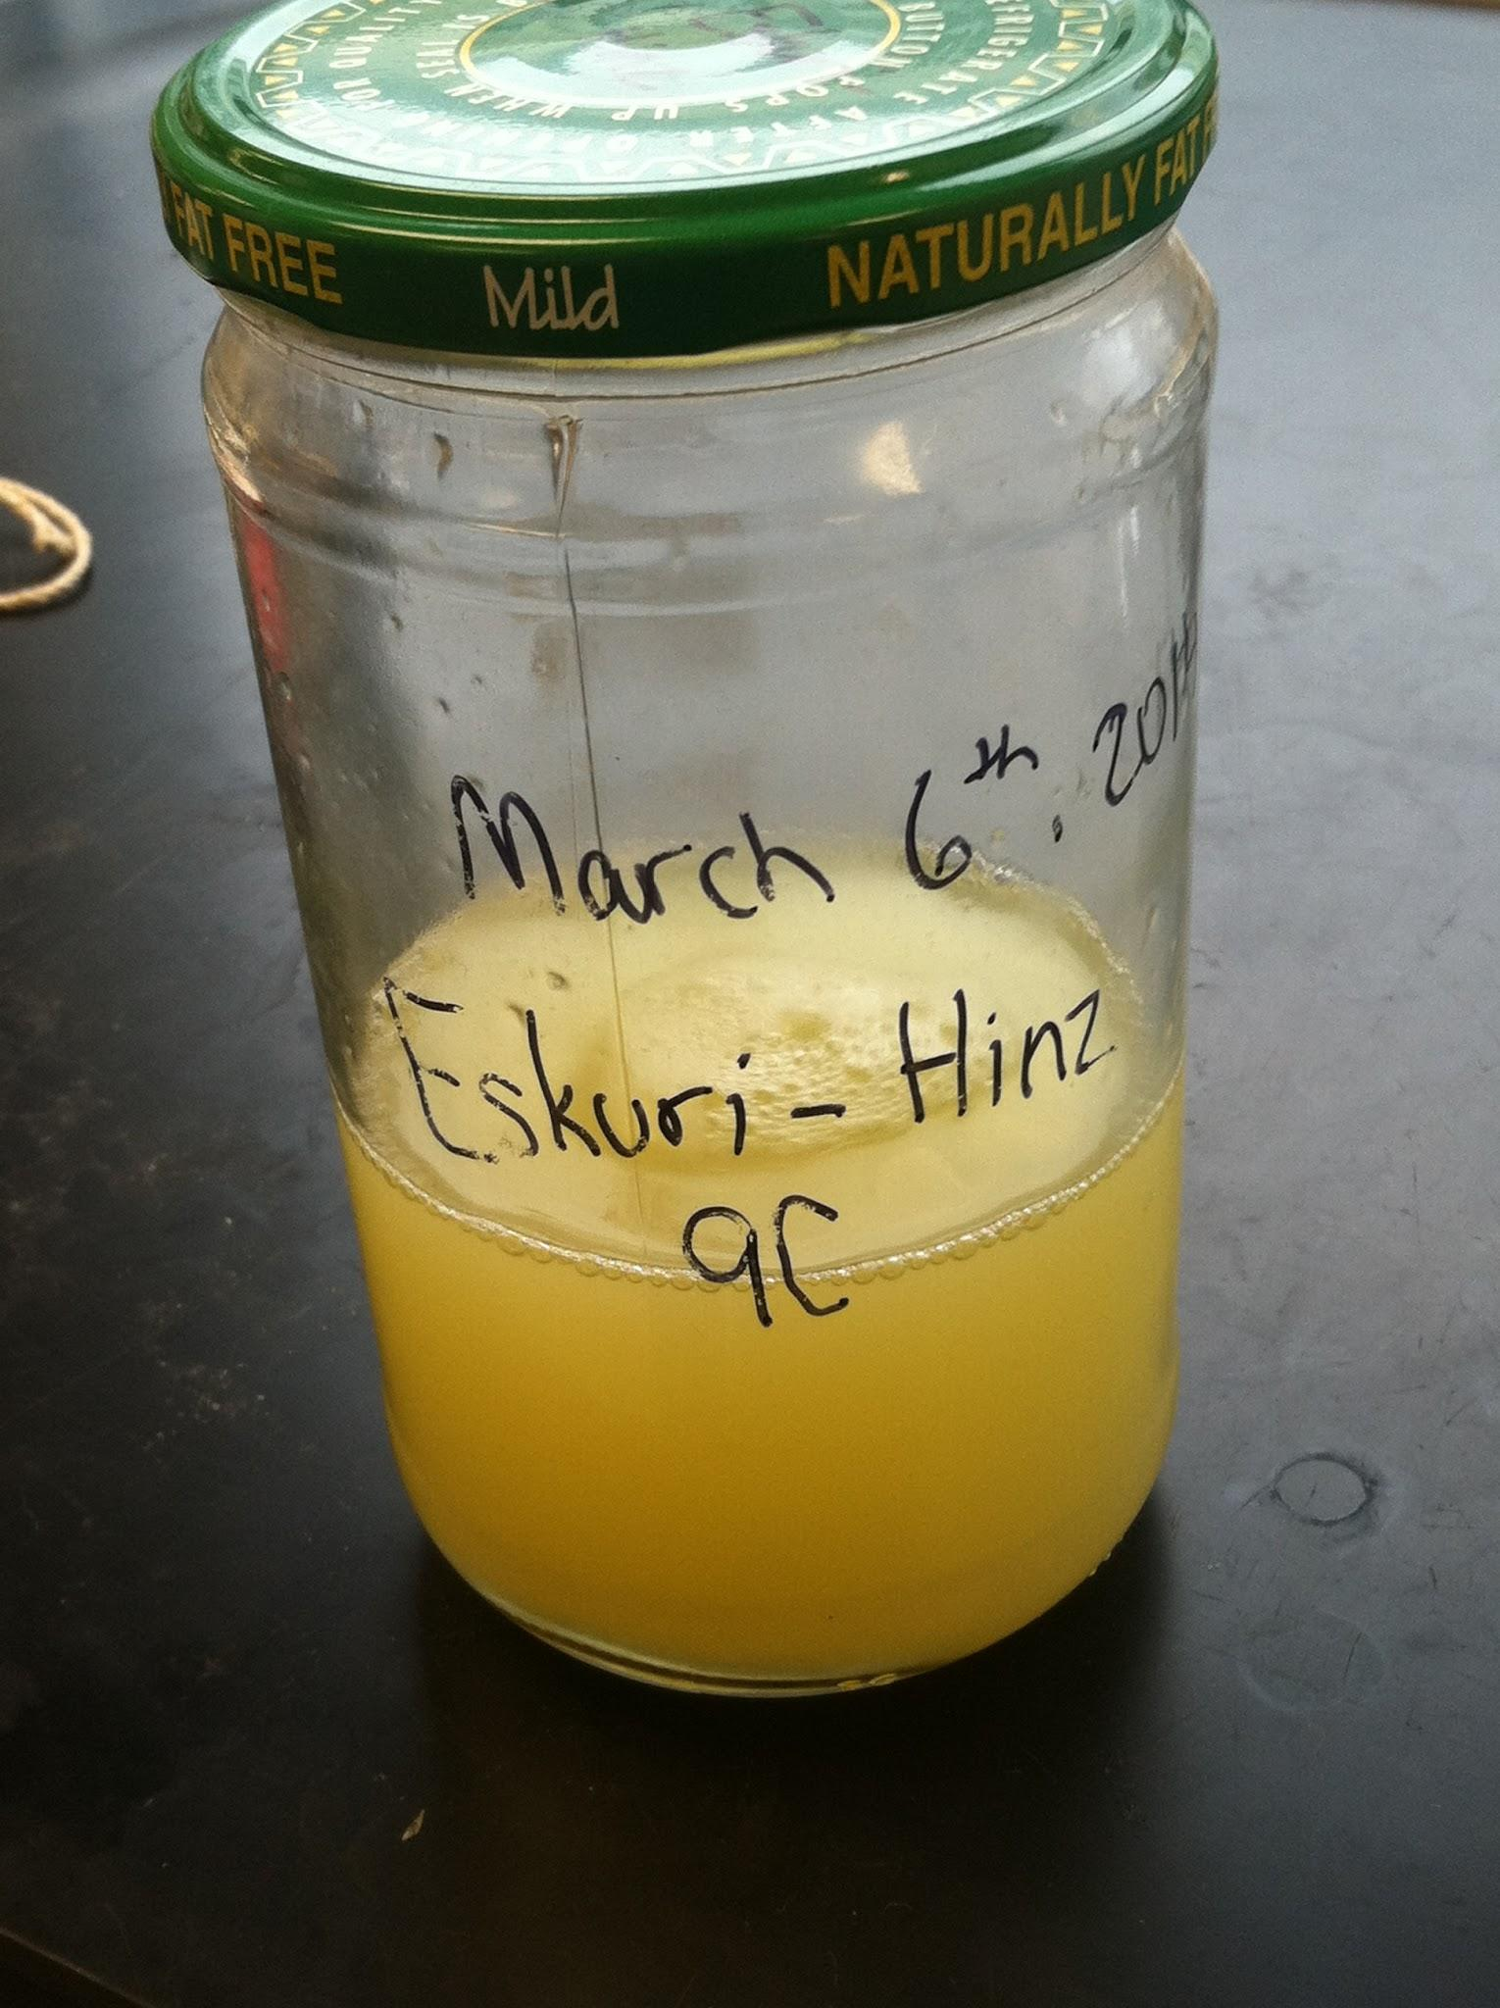
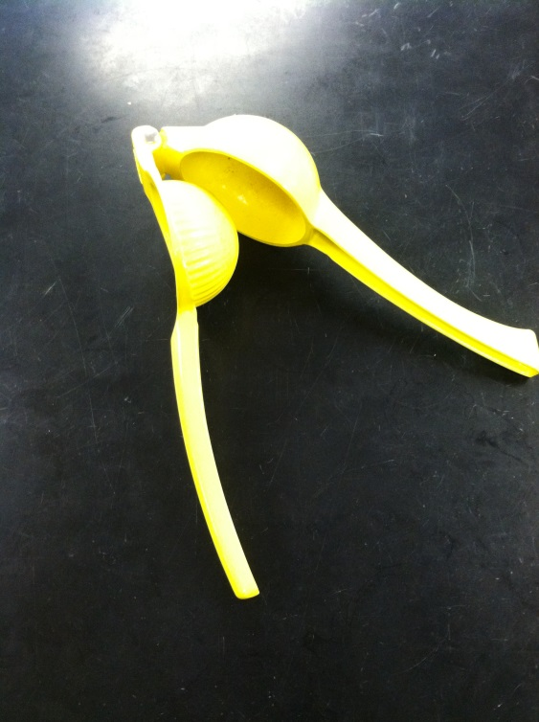
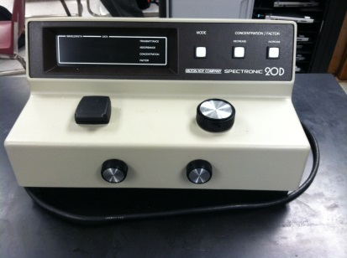
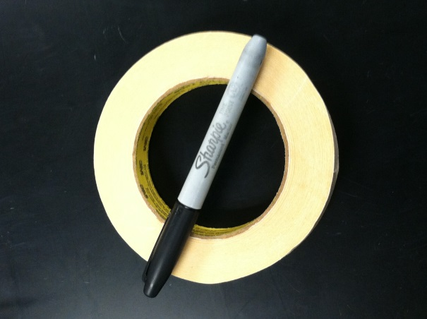
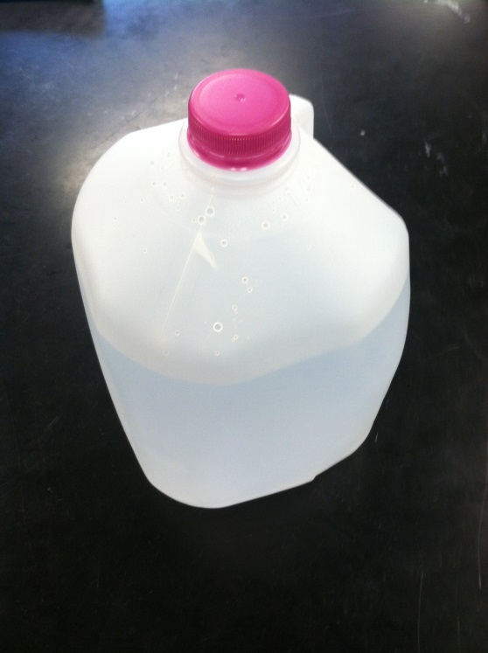
Materials
Escherichia coli
Eye Dropper
Aluminum Foil
Beaker
Bunsen Burner
and Inoculator Loop
Lemon
Incubators
Jar
http://upload.wikimedia.org/wikipedia/commons/e/e4/Lemon.jpg.
Lemon Juicer
Paper Towel
Petri Dish
Spectrometer
Tape and Sharpie
Test Tube Holder with Test Tubes
Water Jug
7
Eskuri-Hinz

Slide 10
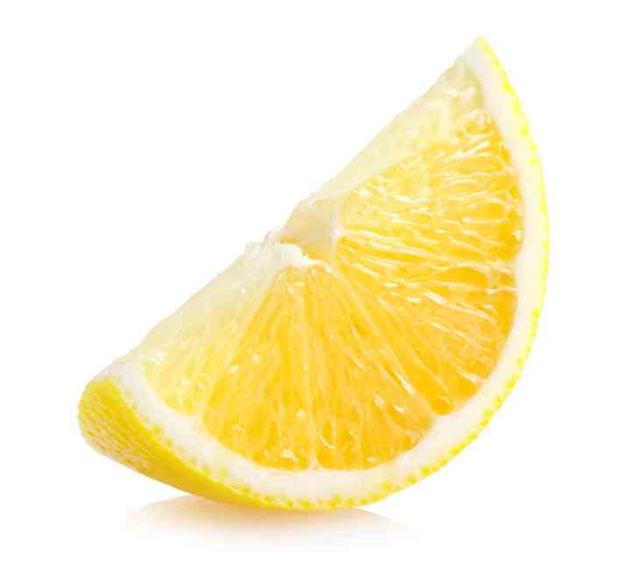
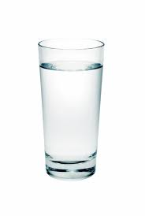
Eskuri-Hinz
8

Slide 11
Eskuri-Hinz
9

Slide 12
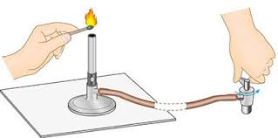
http://ifile.hkedcity.net/1/000/846/public/JCloze.01/JCloze.01/C.03.jpg
Eskuri-Hinz
10

Slide 13
Eskuri-Hinz
11

Slide 14
Standards
Rate of growth of E. coli under the standards
The range of standards= 30.8 lumens.
It should be noted that 90.4* was an outlier that would change the data and make the range of standards way too high, therefore it was removed from the standards table.
Standards
62.4 | 50.6 | 48.8 | 47.2 | 50.0 | 45.6 | 56.8 | 53.6 | 50.8 | 52.2 | 75.2 | 75.0 | 76.4 | 75.6
Eskuri-Hinz
12
1

Slide 15
Scatter Plot of Standards
Eskuri-Hinz
13

Slide 16
 | Growth of E. Coli
 | Lemon Juice Concentration (1, 2, 3 micro liters) Temperature (36, 37, 38 degrees Celsius)
 | Standard | (+,+) | (+,-) | (-,-) | (-,+)
1 | 90.4* | 118.2 | 110.4 | 128.6 | 105.8
2 | 62.4 | 50.8 | 50.0 | 54.8 | 49.0
3 | 50.6 | 50.2 | 52.8 | 31.8 | 46.0
4 | 48.8 | 47.4 | 49.6 | 47.4 | 49.0
5 | 47.2 | 47.4 | 49.6 | 50.6 | 50.4
6 | 50.0 | 48.6 | 51.2 | 48.0 | 49.2
7 | 45.6 | 47.2 | 49.4 | 42.0 | 45.6
8 | 56.8 | 56.0 | 56.2 | 58.8 | 59.4
9 | 53.6 | 57.0 | 56.4 | 57.4 | 58.6
10 | 50.8 | 51.2 | 49.8 | 49.8 | 50.0
11 | 52.2 | 50.8 | 50.0 | 49.4 | 49.4
12 | 75.2 | 72.8 | 76.2 | 78.2 | 72.4
13 | 75.0 | 76.4 | 76.4 | 77.6 | 77.4
14 | 76.4 | 75.4 | 72.6 | 75.0 | 76.6
15 | 71.6 | 76.0 | 59.6 | 77.2 | 76.0
Average | 59.490909 | 57.65714 | 61.47143 | 60.36364 | 60.45455
Eskuri-Hinz
14

Slide 17
Effect of Lemon Juice Concentrate
Lemon Juice Concentrate
- | +
60.36364 | 57.6714
60.45455 | 61.47143
Avg. 60.4091 | Avg. 59.5643
Effect= -0.8448 lumens
Eskuri-Hinz
15

Slide 18
Effect of Temperature
Temperature
- | +
60.36364 | 57.65714
61.47143 | 60.45455
Avg. 60.917535 | Avg. 59.055845
Effect = -1.86169 lumens
Eskuri-Hinz
16

Slide 19
Interaction Effect
Solid Segment Slope=-1.398705
Dotted Segment Slope = 0.553895
Solid – Dotted = -1.9526
Interaction Effect= -1.9526
Eskuri-Hinz
17

Slide 20
Dot Plot of Effects
Eskuri-Hinz
18

Slide 21
Results
The hypothesis for the experiment was that the greater concentration of lemon juice and the higher temperature will decrease Escherichia coli growth.
Eskuri-Hinz
19

Slide 22
Accept or Reject Hypothesis
Rejected
Eskuri-Hinz
20

Slide 23
Results
Not expected
Low pH value of 2
A low pH breaks down the cell membrane of bacteria.
Eskuri-Hinz
21

Slide 24
Improvements
Should have randomized the trials so they weren’t as biased.
Put test tubes in our own beaker because they were moved 3 times.
Lab not accessible everyday.
Eskuri-Hinz
22

Slide 25
Suggestions
Do more research beforehand.
Time management
Eskuri-Hinz
23

Slide 26
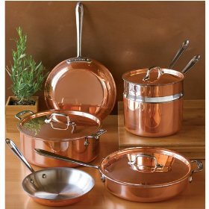
Real World Application
Lemons are antibacterials.
Common in food and drinks.
Clean copper cookware
Disinfect
http://www.amateur-gastronomy.com/wp-content/uploads/2011/10/copper-cookware.jpg
Eskuri-Hinz
24

Slide 27
Other Research
Jessica Behnke and Nicholas Johnson. "Macomb Mathematics Science Technology Center.”
Similar to an experiment from 2012, “The Resistance of Escherichia coli on Lemon Juice and Baking Soda”.
Eskuri-Hinz
25

Slide 28
Recap
Problem
Hypothesis
Procedure
Effects
Results
Eskuri-Hinz
26

Slide 29
Works Cited
"Acids, Bases, & the PH Scale." Acids, Bases, & the PH Scale. Web. 17 May 2014. <http://www.sciencebuddies.org/science-fair-projects/project_ideas/Chem_AcidsBasespHScale.shtml>.
"Bacterial E.coli Growth Media." Bacterial E.coli Growth Media.
Expression Technologies Inc., n.d. Web. <http://www.exptec.com/Expression%20Technologies/Bacteria%20growth%20media.htm>.
Behnke, Jessica, and Nicholas Johnson. "Macomb Mathematics Science Technology Center.” MMSTC. MMSTC, 2008. Web. 04 Feb. 2014.<http://www.wcs.k12.mi.us/mmstc/students/research/biology/2012/behnke-johnson.asp>.
"Clean Copper Cookware.“ 1 June 2014 <http://www.amateur-gastronomy.com/wp-content/uploads/2011/10/copper-cookware.jpg>.
Gordon. E.C. “12 Surprising Health Benefits of Lemons and Limes.” Aviva.ca - Your Health Superstore. Aviva, 2012. Web.13 May 2014. <http://www.aviva.ca/ article.asp?articleid=276>.
Eskuri-Hinz
27

Slide 30
Works Cited
“Lemons.” Mad Food Science. 20 June 2011. Web. 13 May 2014 <http://www.madfoodscience.com/post/6721642761/lemons>.
“Lemons. N.d 1 June 2014. <http://upload.wikimedia.org/wikipedia/commons/e/e4/Lemon.jpg>.
"Microbiology." Microbiology. N.p., n.d. Web. 13 May 2014. <http://www.ilri.org/InfoServ/Webpub/fulldocs/ilca_manual4/Microbiology.htm>.
Eskuri-Hinz
28

Slide 31
Questions?
Eskuri-Hinz
29

